Slide 1

Secured Digital Voting System using Blockchain Technology
Phase II - Review 1
Under the guidance of
Dr. Nagaraja J
Computer Science Department
Dayananda Sagar College of Engineering.
Bhagya A Koushik [1DS19CS037]
Deekshitha R S [1DS19CS044]
Gowthami S [1DS19CS053]
Haritha Nandhini [1DS19CS055]
Department of Computer Science & Engineering, DSCE

Slide 2
INTRODUCTION TO THE PROBLEM
Blockchain is a shared tamper-proof ledger that eases the process of recording transactions and tracking assets in a business network.
Traditional voting system has various disadvantages with respect to its security, fairness and integrity.
Digital voting is a form of computer driven voting in which voters can cast their votes on a system over the internet.
It employs a decentralized blockchain network to monitor the entire election process.
SHA- 256 algorithm is used to ensure encryption of the votes and avoid any kind of manifestation of votes during the election.
It generates a user- friendly election environment over the internet to allow the users to cast their votes to their candidates of interest and also announces the final results giving information about the winner and also the election statistics.
Department of Computer Science & Engineering, DSCE

Slide 3
Contribution of Each project Members
Individual Contribution
Bhagya A Koushik
MetaMask linking and ganache
Deekshitha R S
Smart Contract - Voter
cv
Gowthami S
Smart Contract - Candidate
Haritha Nandhini
User Interface
Department of Computer Science & Engineering, DSCE

Slide 4
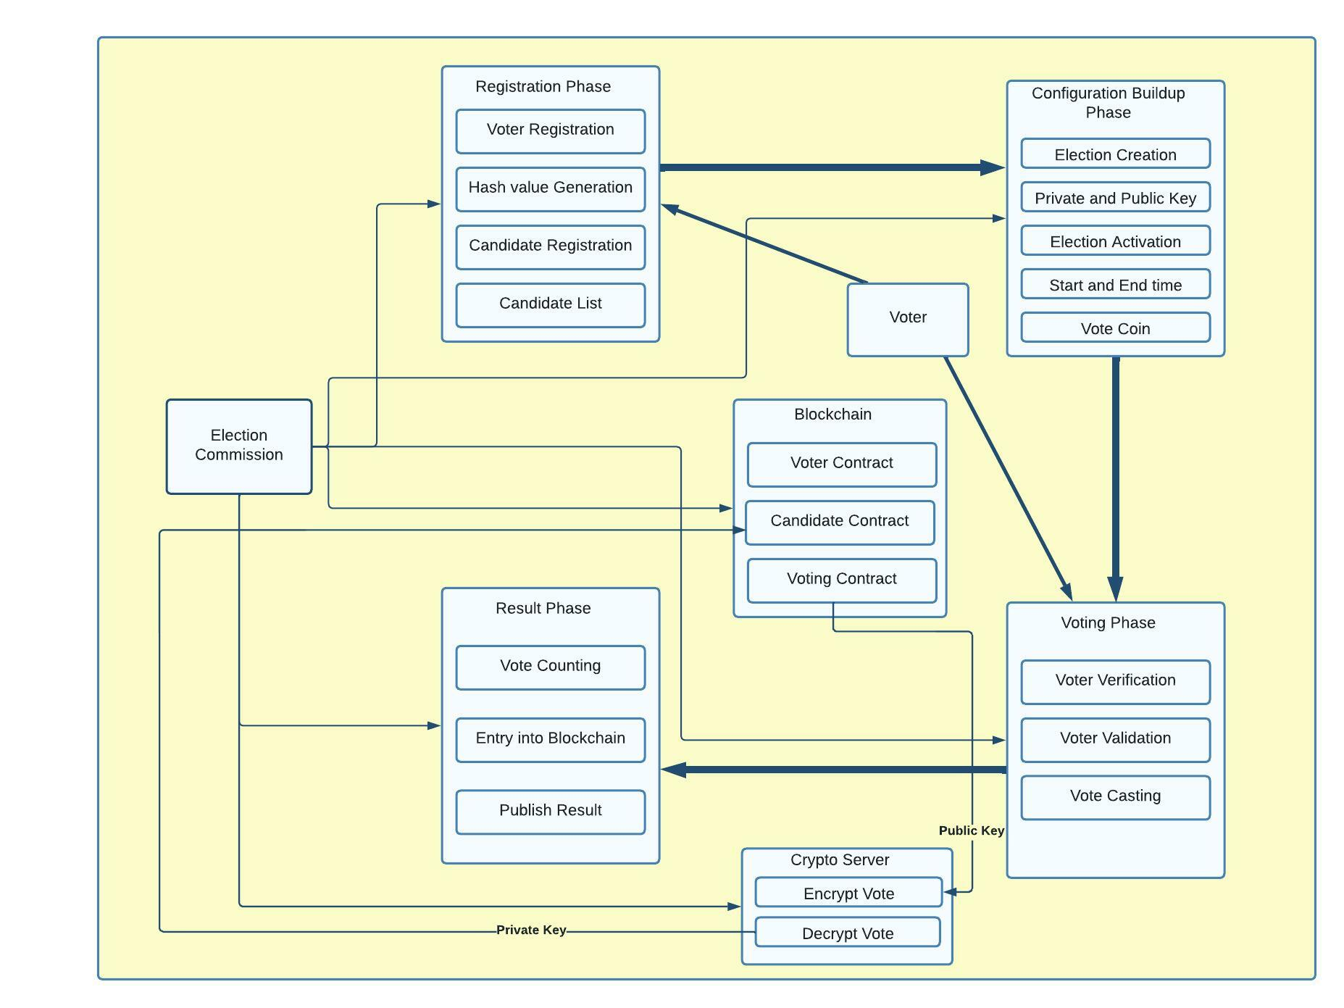
SYSTEM DIAGRAM / ARCHITECTURE:
Department of Computer Science & Engineering, DSCE

Slide 5
MODULES
The proposed voting mechanism includes four modules:
First Phase: Registration Phase
Second Phase: Voting Setup Phase
Third Phase: Voting Phase
Fourth Phase: Result Phase

Slide 6
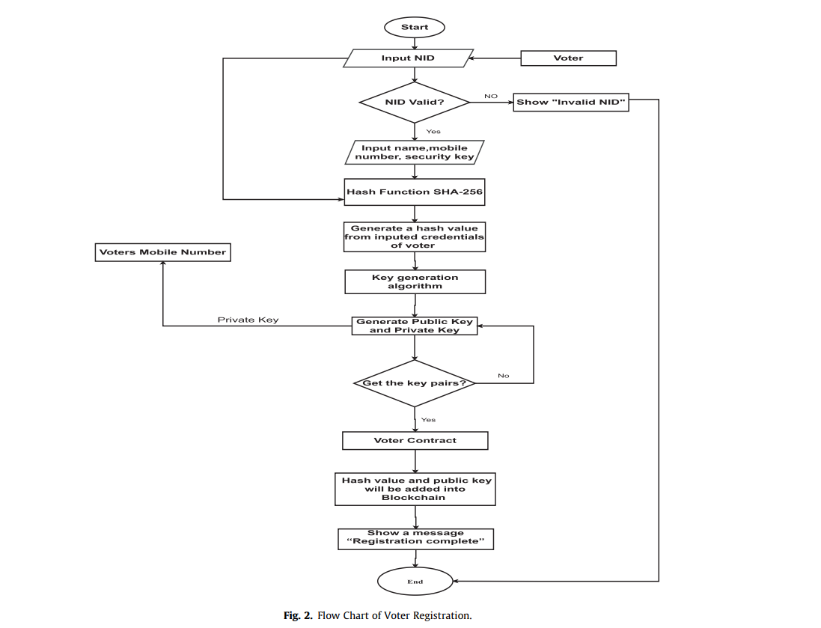
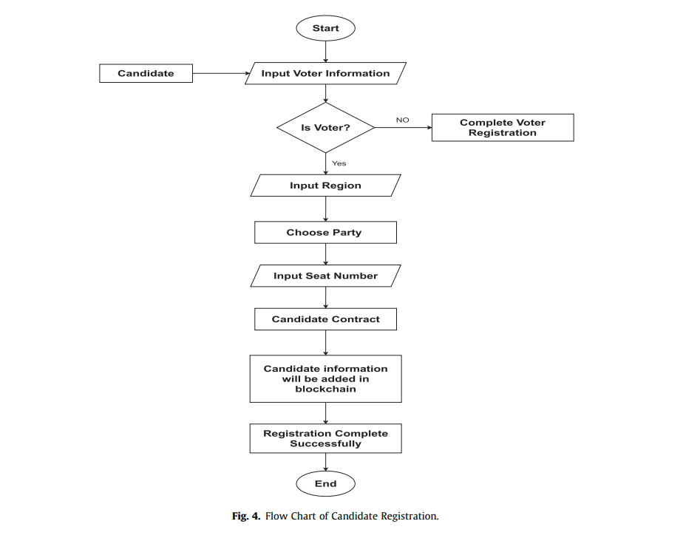
MODULES DESCRIPTIONS
First phase
The First phase of voting system consists of
Registration unit which has two parts:
Voters registration
Candidate Registration

Slide 7
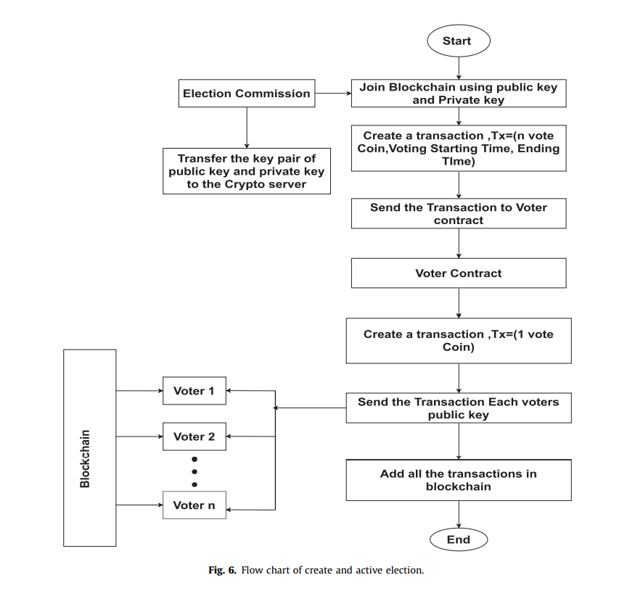
MODULES DESCRIPTIONS
Second phase
Voting Setup Phase
This phase is divided into two parts:
Create Election
Active Election

Slide 8
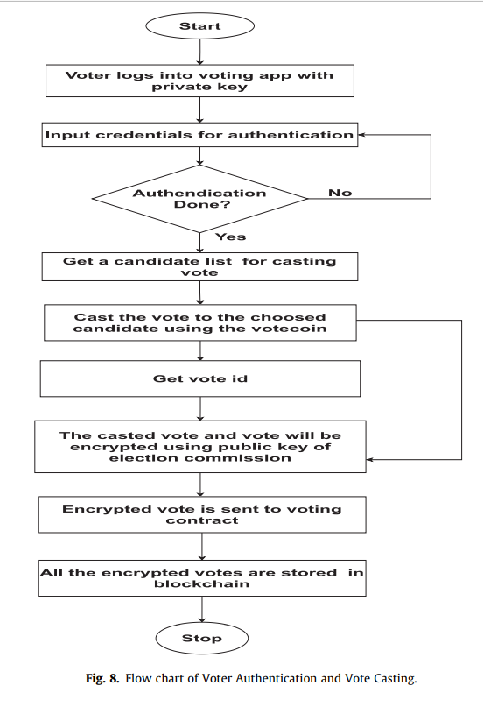
MODULES DESCRIPTIONS
Third phase
Voting Phase
This phase is divided into two parts:
Voter Authentication
Vote Casting

Slide 9
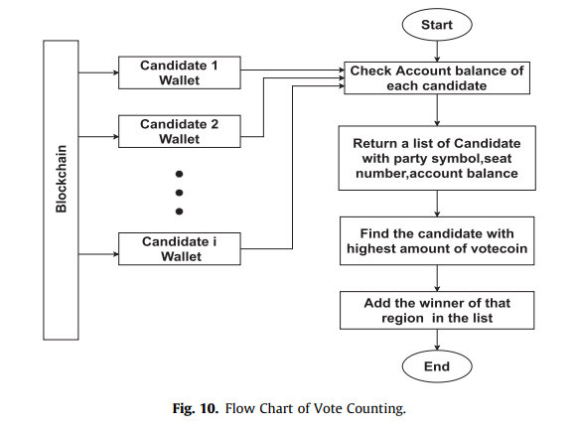
MODULES DESCRIPTIONS
Fourth phase
Result Phase
This phase consists of:
Vote Counting Unit
Publish Result

Slide 10
ALGORITHM
SHA 256 is a part of the SHA family of algorithms.
SHA stands for Secure Hash Algorithm.
SHA-256 is a unidirectional algorithm which brings in enhanced security to a blockchain system.
It ensures encryption of the votes and avoid any kind of manifestation of votes during the election.
Once it is encrypted, there is no other way to decrypt it without using the private key.
This ensures a tamper proof ledger and thereby ensures that the votes are not altered in any way.
Department of Computer Science & Engineering, DSCE

Slide 11
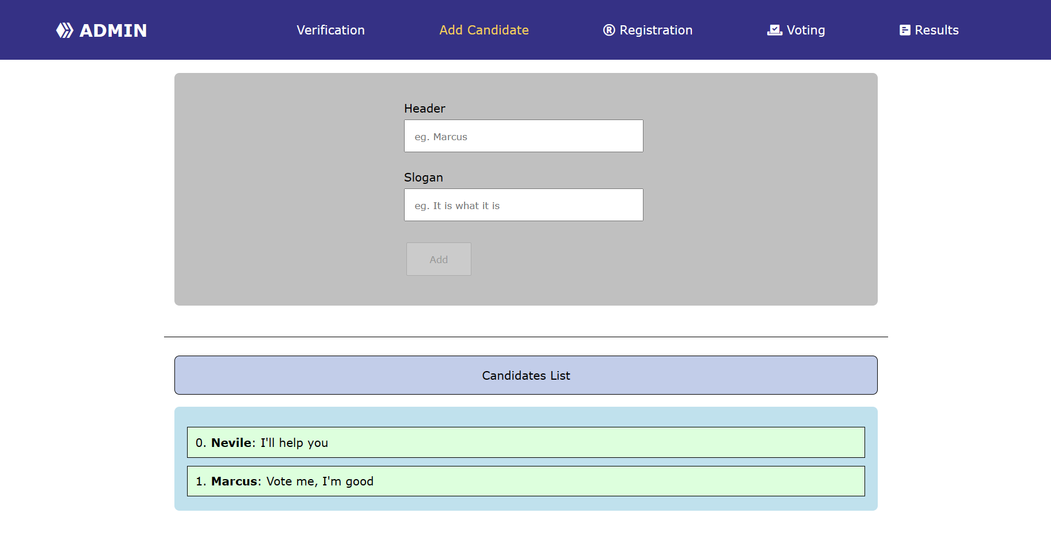
GUI DESIGN SCREENSHOTS
Adding candidates
Department of Computer Science & Engineering, DSCE

Slide 12
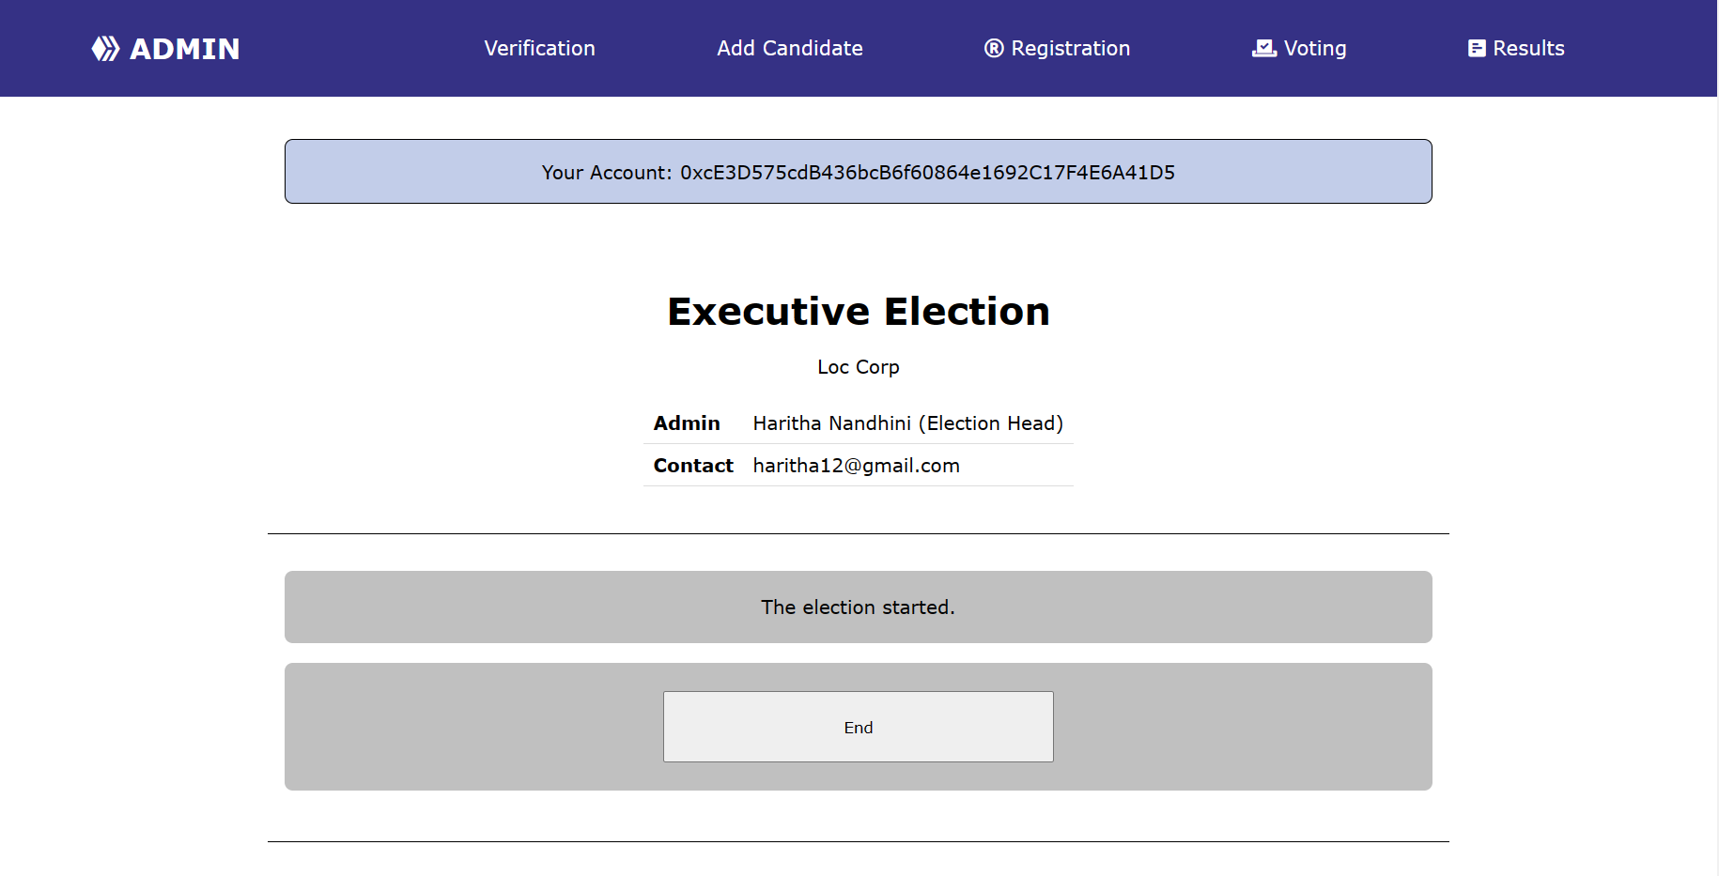
GUI DESIGN SCREENSHOTS
Starting Election
Department of Computer Science & Engineering, DSCE

Slide 13
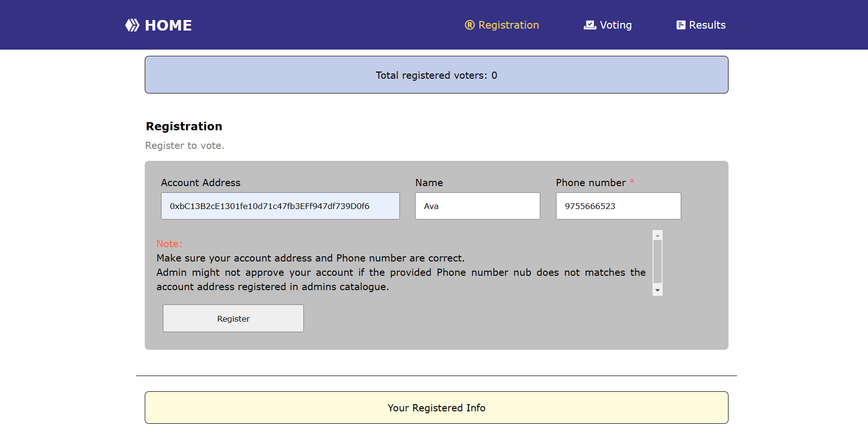
GUI DESIGN SCREENSHOTS
Voter Registration
Department of Computer Science & Engineering, DSCE

Slide 14
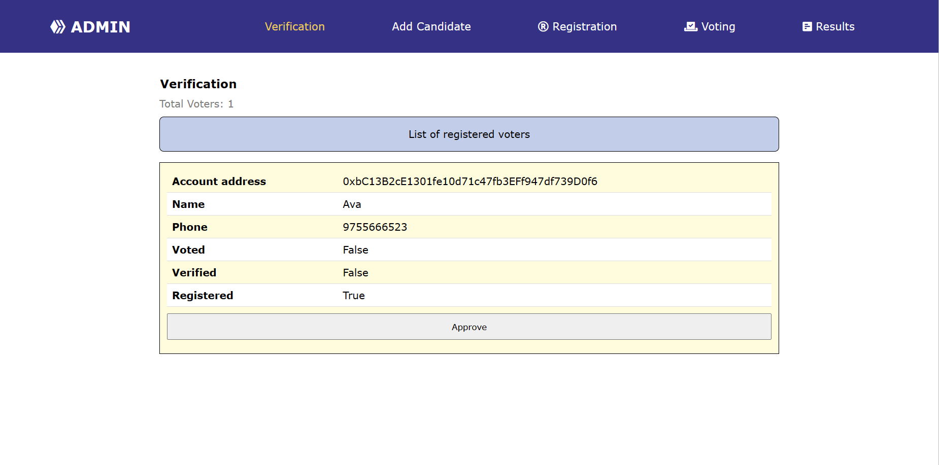
GUI DESIGN SCREENSHOTS
Voter Verification
Department of Computer Science & Engineering, DSCE

Slide 15
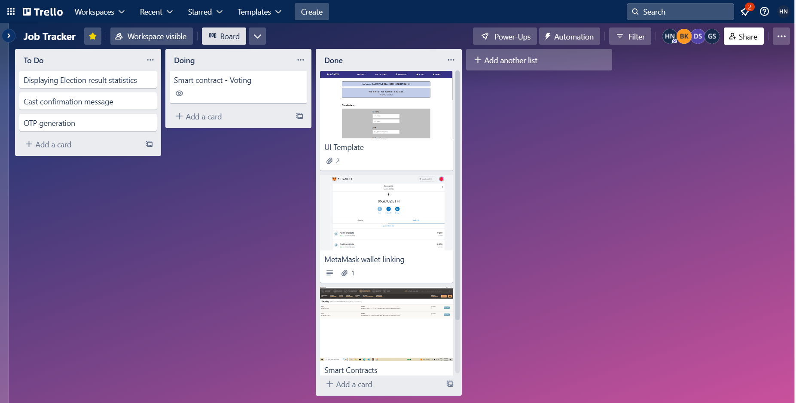
PROJECT TOOL SNAPSHOT
Department of Computer Science & Engineering, DSCE

Slide 16
THANK YOU!
Department of Computer Science & Engineering, DSCE

